Slide 1
neoclassical.ai
The Paths of Point Potentials
Notes:
Hi. Welcome to this episode of Emergent Nature.
My name is J Mark Morris. I go by Mark.
In this episode I’ll discuss the error that caused science to go off track into general relativity and quantum mechanics.
That may seem like an unusual thing to say, since general relativity and quantum theory are generally considered to be successful effective theories.
However, as we will see, an error circa 1900 threw science off track.
There is a parsimonious solution to nature.

Slide 2
Point Potential on Linear Path with Velocity v = 0
r = @t
Field Speed @ is a Universal Constant
Absolute
Euclidean
3D Space
Electric Potential Field Tracers
A point potential with velocity = 0 emits potential spheres, all with the same origin.
Absolute Euclidean Time
J Mark Morris
Notes:
In mathematics, the Dirac delta distribution (δ distribution), also known as the unit impulse symbol, is a generalized function or distribution over the real numbers, whose value is zero everywhere except at zero, and whose integral over the entire real line is equal to one. - Wikipedia

Slide 3
Point Potential on Linear Path with Velocity v < @
r = @t
Field Speed @ is a Universal Constant
Point Potential Path
Absolute
Euclidean
3D Space
v < @
Electric Potential Field Tracers
Each point potential continuously emits an electric potential field.
The electric potential is q/v at r=0 and a spherical Dirac delta q/vr as a linear function of time.
When v < @ the point potential does not experience its own field and there is no self action.
Absolute Euclidean Time
J Mark Morris
Notes:
In mathematics, the Dirac delta distribution (δ distribution), also known as the unit impulse symbol, is a generalized function or distribution over the real numbers, whose value is zero everywhere except at zero, and whose integral over the entire real line is equal to one. - Wikipedia

Slide 4
Spherical Emissions Expand at v = @
Each Dirac Sphere Expands from the Point of Emission
r = @t
Field Speed @ is a Universal Constant
Absolute
Euclidean
3D Space
Point Potential Path
v < @
Electric Potential Field Tracers
Absolute Euclidean Time
J Mark Morris
Notes:
In mathematics, the Dirac delta distribution (δ distribution), also known as the unit impulse symbol, is a generalized function or distribution over the real numbers, whose value is zero everywhere except at zero, and whose integral over the entire real line is equal to one. - Wikipedia

Slide 5
Action Occurs when a Potential Sphere Intersects a Point Potential
Action = Force along Radius to Emission Point
r = @t
Absolute
Euclidean
3D Space
Point Potential Path
v < @
Absolute Euclidean Time
J Mark Morris
Notes:
In mathematics, the Dirac delta distribution (δ distribution), also known as the unit impulse symbol, is a generalized function or distribution over the real numbers, whose value is zero everywhere except at zero, and whose integral over the entire real line is equal to one. - Wikipedia

Slide 6
Point Potential on Linear Path with Velocity v = @
@
v = @
Absolute
Euclidean
3D Space
Electric Potential Field Tracers
Imagine a point potential with linear velocity v = @, the electric potential field speed.
The point potential does not experience self action.
This symmetry breaking point is related to quantum mechanics symmetry breaking.
Symmetry breaking at Wien’s peak occurs when the binary potential velocities are v = @.
There may be a relation or duality with a black hole event horizon.
Absolute Euclidean Time
J Mark Morris
Notes:
In mathematics, the Dirac delta distribution (δ distribution), also known as the unit impulse symbol, is a generalized function or distribution over the real numbers, whose value is zero everywhere except at zero, and whose integral over the entire real line is equal to one. - Wikipedia

Slide 7
Point Potential on Linear Path with Velocity v > @
@
Absolute
Euclidean
3D Space
v > @
Electric Potential Field Tracers
Imagine a point potential with linear velocity v > @, the electric potential field speed.
The point potential outpaces its own potential field.
When v > @ the point potential experiences its own field and there is self action.
Absolute Euclidean Time
J Mark Morris
Notes:
In mathematics, the Dirac delta distribution (δ distribution), also known as the unit impulse symbol, is a generalized function or distribution over the real numbers, whose value is zero everywhere except at zero, and whose integral over the entire real line is equal to one. - Wikipedia

Slide 8
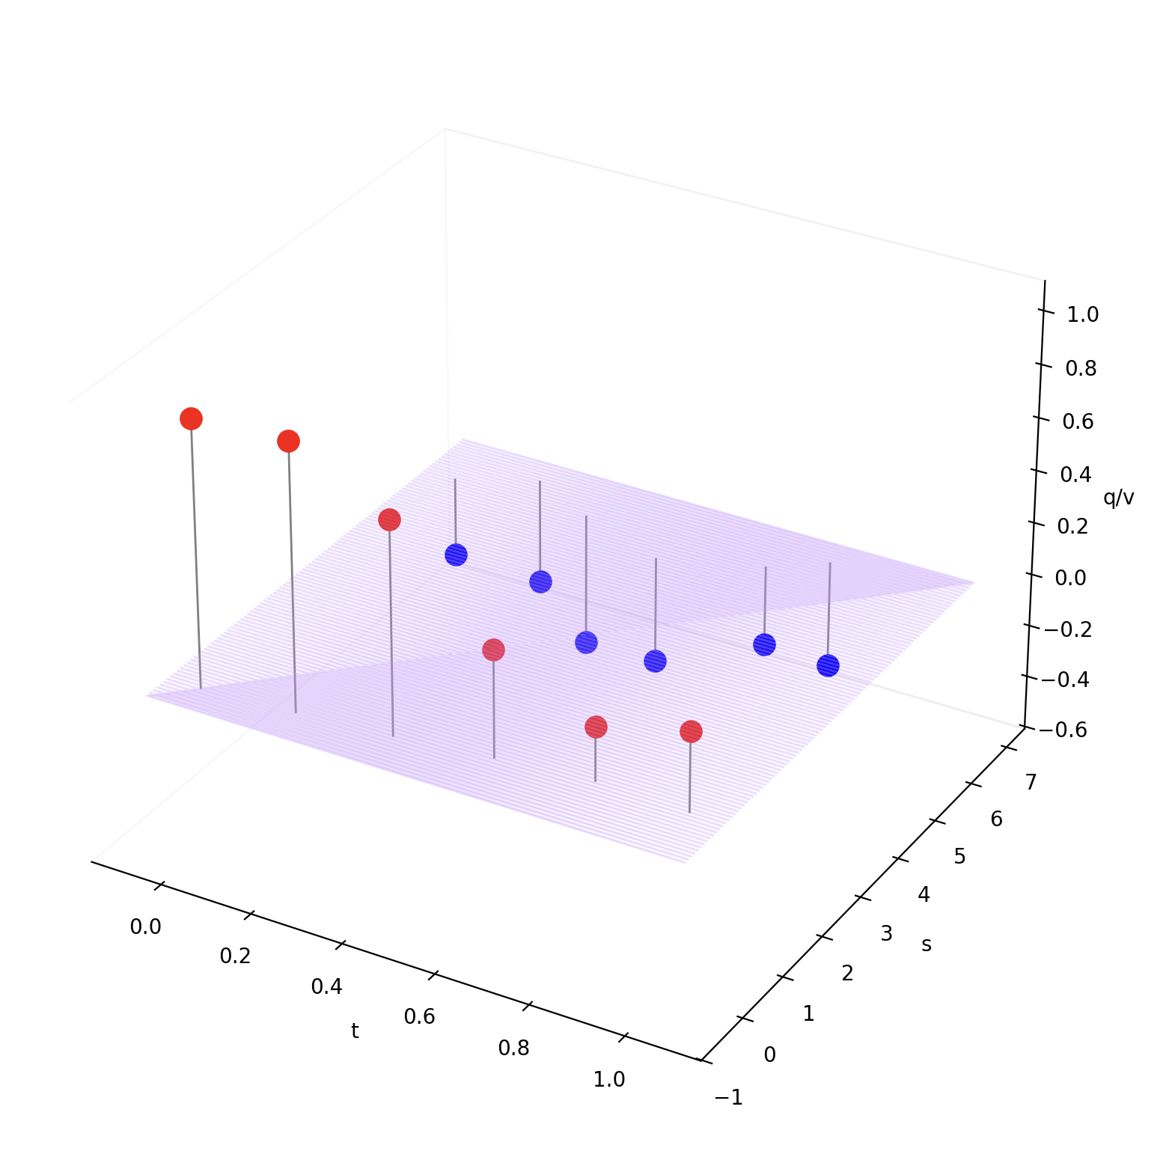
Emission Magnitude Depends on Path
Paths are continuous through time and space.
Emission rate is a constant dq/dt
At v = 0, emission magnitude is q
At v > 0, emission magnitude is q/v
The potential magnitude at the surface of each Dirac sphere decreases as 1/r², where r is the radius to the emission point, the sphere center
J Mark Morris

Slide 9
Point Potential Path History and Action
A
A(t)
Absolute
Euclidean
3D Space
A(t’)
B(t)
B
The potential emitted by charge A at time t’ expands spherically at field speed @.
Action occurs when the potential sphere intersects charge B at time t.
Absolute Euclidean Time
J Mark Morris
Notes:
Lienard and Wiechert were scientists.
Among the areas they each researched were point charges, the paths of point charges, the history of the potential emitted by point charges, and the action on point charges when potential intersects with them.
Shown in this figure are two point charges A and B.
They move around through space and time on a path.
That movement is due to the action upon those point charges from all intersecting potential waves.
Let's start by looking at the influence that point charge A has on point charge B at time t.
What we see is that at time t', point charge A has emitted potential that expands spherically and intersects point charge B at time t.
The radius of a spherical potential wave increases at the universal constant field speed, which I have given the at sign symbol.
The speed of potential is not the same as the speed of light, c, although they are related, which will be explained in a future episode.
What we see is that there is a delay. It's not that the current position of A impacts B at time t.
Rather it is a historical position on A's path where A emitted potential that now intersects B at time t.
The distance between A(t') and B(t) is given by field speed multiplied by the time difference between t' and t.
Action occurs when a potential wave intersects a point charge and this influences the future path of point charge.
This action is not only a function of the distance between A(t') and B(t), but also the velocity of A at time t' and the velocity of B at time t.
This system evolves as a dynamical geometry. This is true whether it is two isoloated point charges or all point charges in the universe, even if that is a countably infinite number of point charges.
There are some fascinating behaviors in this dynamical geometry.
Each point charge is continuously emitting a potential wave that expands spherically.
In our example, point charge A emitted a potential wave at time t' that resulted in action on point charge B at time t. That action influences B's path. Yet B is also continuously emitting potential. So when B's path changes that will be reflected in the potential wave it emits. This wave then results in action on point charge A when they intersect. This dynamical feedback is continuous between both point charges in our example, and in the universe between all point charges.
Overall, this dynamical geometry mirrors Mach's principle, but with charge instead of mass.
Point charges continuously emit potential that expands spherically.
Intersecting spherical potential waves tell point charges how to move.
In our example we have shown the relationship between two point charges, but it is also possible for self-action to occur, where a point charge responds to potential it emitted on its own past path history. We'll cover this topic in detail in a future episode.

Slide 10
Point Potential Path History and Action
It is fascinating to conceptualize continuous feedback with a delay.
Action upon A changes A’s path which changes the sphere stream A emits.
After a travel time, which is also path dependent, action will occur at B and change B’s path.
And so on. This is all continuous feedback.
A(t)
A
Absolute
Euclidean
3D Space
A(t’)
B
B(t)
Absolute Euclidean Time
J Mark Morris
Notes:
The tracer circles represent spheres in 3D absolute represent the 3D spatial length of the radius. The forward tilt of all arrows represents absolute time. Essentially every point potential is continuously riding on the wake emitted by every other point potential in the past. They may also be riding on their own wake if v > @. For each partner that has operated at v>@ a point potential may encounter multiple of their wakes or a continuous stretch of wake? What path would yield a continuous stretch of wake from a partner?
To do : animate this and make an episode.

Slide 11
Point Potential Path History and Action
Absolute
Euclidean
3D Space
A(t)
A(t’)
B(t)
The potential emitted by A at time t’ causes action upon intersecting B at time t.
Absolute Euclidean Time
J Mark Morris
Notes:
The tracer circles represent spheres in 3D absolute represent the 3D spatial length of the radius. The forward tilt of all arrows represents absolute time. Essentially every point potential is continuously riding on the wake emitted by every other point potential in the past. They may also be riding on their own wake if v > @. For each partner that has operated at v>@ a point potential may encounter multiple of their wakes or a continuous stretch of wake? What path would yield a continuous stretch of wake from a partner?

Slide 12
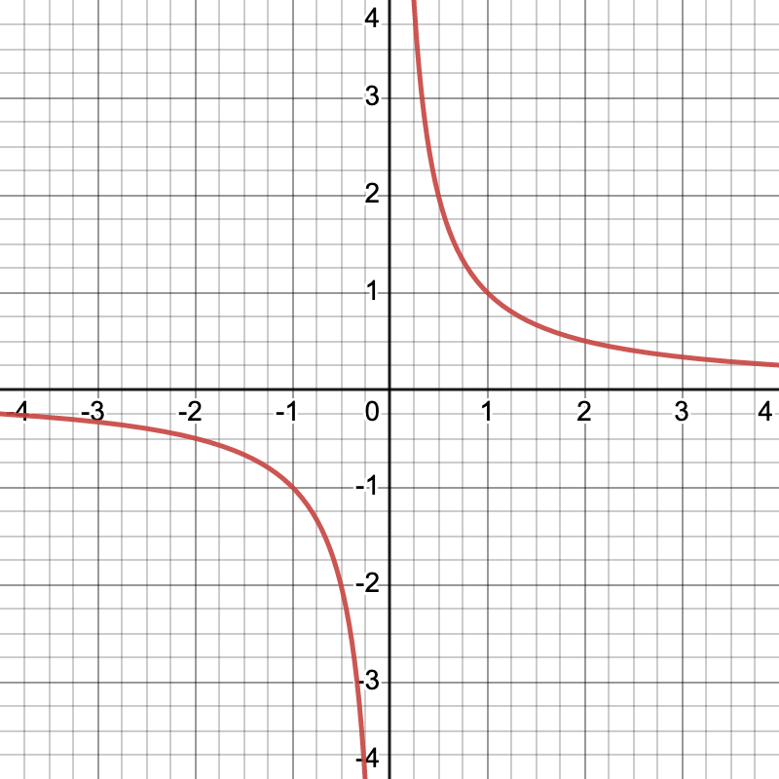
Brainstorming the Radius of Potential
A 1D Euclidean line with exactly two (2) point potentials emitters and field speed @
The symmetry point in a binary assembly is when point potential speed |v| = @.
Does the binary symmetry point correspond to the 1:1 symmetry point in the 1/r curve as well (x=1/y, y=1/x)? I suspect it may.
The one-sided integrals above and below r=1 increase symmetrically.
Is this why orbital equations scale with |v| and r?
If trans (opposite polarity) potentials launch at large r, and speed +delta, delta near 0
Will they reach |v| very near @ at r=1?
What is the ultimate velocity as they pass through each other?
Symmetry with binaries suggests v = @ pi / 2.
If cis (same polarity) potentials launch to each other with a speed >> @ + delta
Is the r = 1 case where they would reverse course or cross depending on delta?
Cis vs. Trans point potentials are a profound asymmetry in nature.
Kinda profound, but if the point potential is boosted it can cross the 1/1 location.
Note: radius and velocity are intertwined.

Slide 13
Absolute
Euclidean
3D Space
A Model of Nature
Absolute Time
linear (1D)
forward moving
Absolute Space
3D Euclidean
no origin, orientation, translation.
Point Potential Emitter/Receivers
equal and opposite
constant rate emitters
potential receivers
travels establish a path in R4
may travel faster than emission
Paths of a Point Potential
continuous history in time and space
path = all [q,t,x,y,z,x’,y’,z’] for all t < t_{now}
Emission
origin is on path
constant rate potential emission
Dirac delta q/v
Dirac sphere stream (1/r curve)
expands at field speed @. r = @t
Action
action occurs at t = t_{now}
[q,t,s,s’] intersection with sphere stream
superposition
net action determines path change
Point Potential Densities (Large Scale)
population per volume
energy carried by point potentials
population distribution (50/50)
t = t_{now}
Absolute Linear Forward Moving Time
J Mark Morris
Notes:
Lienard and Wiechert were scientists.
Among the areas they each researched were point charges, the paths of point charges, the history of the potential emitted by point charges, and the action on point charges when potential intersects with them.
Shown in this figure are two point charges A and B.
They move around through space and time on a path.
That movement is due to the action upon those point charges from all intersecting potential waves.
Let's start by looking at the influence that point charge A has on point charge B at time t.
What we see is that at time t', point charge A has emitted potential that expands spherically and intersects point charge B at time t.
The radius of a spherical potential wave increases at the universal constant field speed, which I have given the at sign symbol.
The speed of potential is not the same as the speed of light, c, although they are related, which will be explained in a future episode.
What we see is that there is a delay. It's not that the current position of A impacts B at time t.
Rather it is a historical position on A's path where A emitted potential that now intersects B at time t.
The distance between A(t') and B(t) is given by field speed multiplied by the time difference between t' and t.
Action occurs when a potential wave intersects a point charge and this influences the future path of point charge.
This action is not only a function of the distance between A(t') and B(t), but also the velocity of A at time t' and the velocity of B at time t.
This system evolves as a dynamical geometry. This is true whether it is two isoloated point charges or all point charges in the universe, even if that is a countably infinite number of point charges.
There are some fascinating behaviors in this dynamical geometry.
Each point charge is continuously emitting a potential wave that expands spherically.
In our example, point charge A emitted a potential wave at time t' that resulted in action on point charge B at time t. That action influences B's path. Yet B is also continuously emitting potential. So when B's path changes that will be reflected in the potential wave it emits. This wave then results in action on point charge A when they intersect. This dynamical feedback is continuous between both point charges in our example, and in the universe between all point charges.
Overall, this dynamical geometry mirrors Mach's principle, but with charge instead of mass.
Point charges continuously emit potential that expands spherically.
Intersecting spherical potential waves tell point charges how to move.
In our example we have shown the relationship between two point charges, but it is also possible for self-action to occur, where a point charge responds to potential it emitted on its own past path history. We'll cover this topic in detail in a future episode.

Slide 14
Thank You
Questions?

Slide 15
neoclassical.ai
Solving Zeno’s Paradox
Notes:
Hi. Welcome to this episode of Emergent Nature.
My name is J Mark Morris. I go by Mark.
In this episode I’ll discuss the error that caused science to go off track into general relativity and quantum mechanics.
That may seem like an unusual thing to say, since general relativity and quantum theory are generally considered to be successful effective theories.
However, as we will see, an error circa 1900 threw science off track.
There is a parsimonious solution to nature.

Slide 16
Nature’s Solution to Zeno’s Paradox and the 1/r Potential Curve
Nature is a pure geometry defined by continuous paths of equal and opposite point potentials. It’s a path theory!
Each path is an open ended string headed by a point potential emitter/receiver. (Nature echos at many scales)
Emission is constant q/t
Action occurs when a receiver intersects a sphere stream. (superposition applies)
t=now of curvy paths in s (graph).
because point potentials can exceed their own field speed, we have a symmetry breaking point between two regions, as a bonus we get a maximum curvature in a binary (or orbiting/translating binary)
An ideal binary (and ideal elliptical?) has symmetry such that the point potentials must experience the equivalent action. When v=0 and no axial rotation (holy cow now we also have to compute the effects of a rotation of the binary around one other dimension.
There may be equivalent geometrical models. Or models that express these concepts in more abstract mathematical terms. That itself is kind of mindblowing. We think we are reality. In a sense we are a simulation of reality.
Put these points on copies of my new this is nature slide in this deck.
J Mark Morris

Slide 17
Nature’s Solution to Zeno’s Paradox and the 1/r Potential Curve
The 1/r curve is how the geometry of potential works in nature.
The reason Zeno’s Paradox is solved is that nature is not constrained so that every point potential relationship be on a 1/r potential curve.
Point potentials routinely pass through 1/r potential curves on a per relationship basis.
Argument via superposition: the receiver point potential has infinite (check) solutions on the vector line defined by E>A.
And that is only one relationship. There are a countable infinity of relationships.
what about v>@. If it became isolated and all potential was it’s own repelling potential, well then what? It would accelerate to some limit or infinite? Have to calculate the force from the 1/r curve given the energy just somehow edged v > @.
It’s sort of like it would ride it’s own surf, continuously accelerating but by smaller amounts. what is the integral of 1/r? ln(r)?
Point potentials can move through Dirac sphere streams and vice versa
A point potential is always intersecting at least one Dirac sphere from all other point potentials
Each point potential has vector velocities a) on the geodesic and b) on the line to the point of emission of each intersecting sphere stream.
And as your velocity adjusts, you are either surfing farther away in time, steady time, or closer in time to the point of emission.
hmm, that’s interesting. the surfer doesn’t really see a 1/r curve.
J Mark Morris

Slide 18
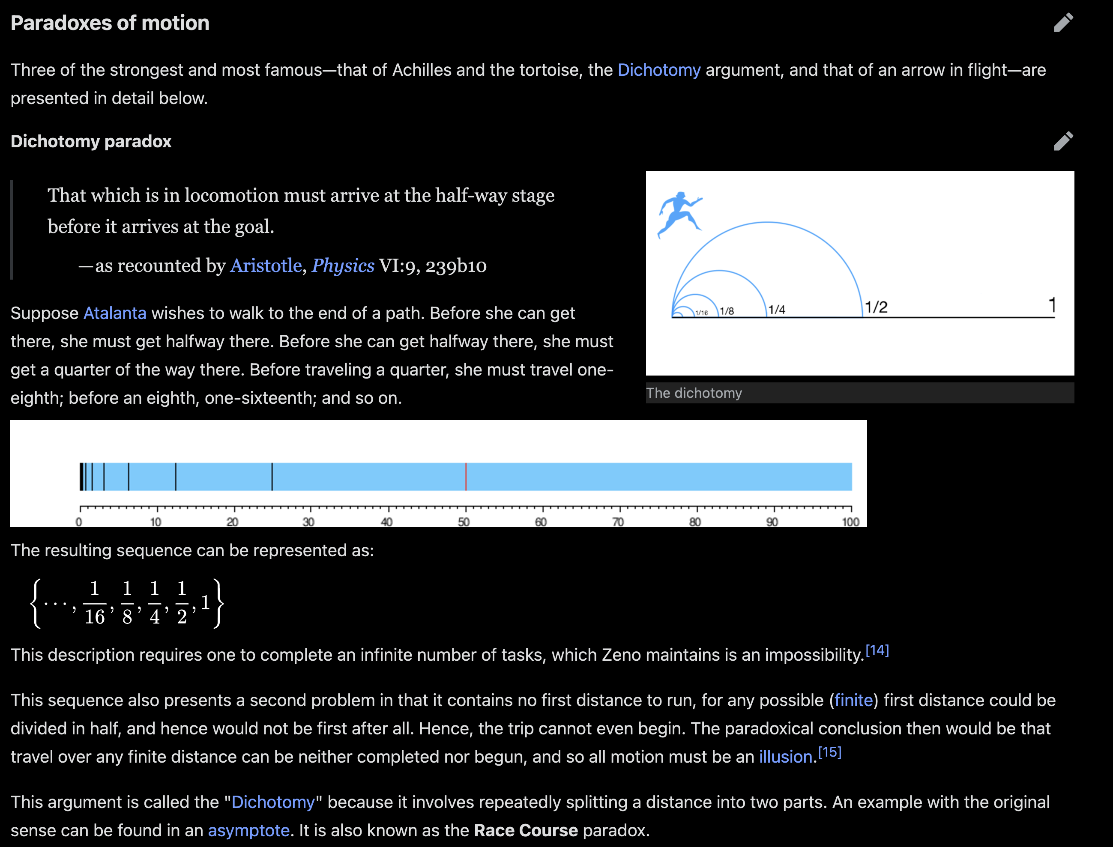
Nature’s Solution to Zeno’s Paradox and the 1/r Potential Curve
Zeno’s paradox
J Mark Morris

Slide 19
Nature’s Solution to Zeno’s Paradox and the 1/r Potential Curve
add a 1/r curve – positive and negative
expand this into a set of slides
search for meme’s.
check references
aha – I had this idea in my geometry of nature mindmap!
J Mark Morris

Slide 20
Imagine. Visualize. Represent.

